Slide 1
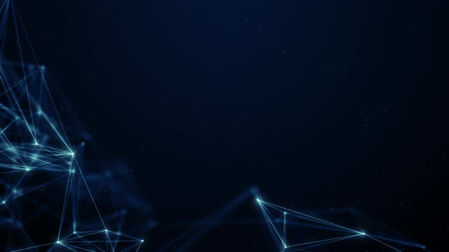
S2S: A Sign language to Speech Conversion Module (For Beginners)
By
Mohammad Ashraf (2020-350-039)
Under the Supervision of Dr . Sapna Jain

Slide 2

Objective
Enable communication between sign language users and non-sign language speakers.
Bridge the communication gap between the deaf or hard of hearing community and broader society.
Enhance inclusivity and facilitate seamless interaction across linguistic and cultural backgrounds.
Focus on the core operations to allow maximum scope for future enhancements.

Slide 3
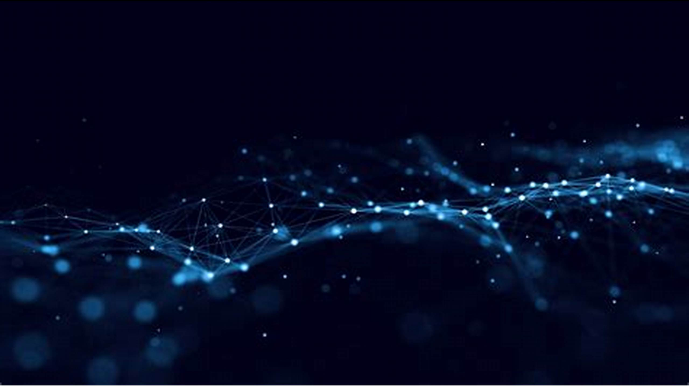
Introduction
Sign language is a fundamental mode of communication for millions of individuals worldwide with hearing impairments.
the deaf community often faces challenges in effectively communicating with the hearing population.
Recognizing these challenges, my project aims to develop a transformative solution: a Sign Language to Speech Conversion System.
This system holds immense promise in enhancing accessibility, promoting inclusivity, and empowering individuals with hearing impairments.

Slide 4

Problem Statement
Absence of sign language interpreters creates communication barriers for the deaf community.
Social isolation and restricted access to information and services are consequences of communication barriers.
Need for a comprehensive Sign Language to Speech Conversion System to bridge communication gap.
Aim to develop an efficient and user-friendly system to promote accessibility and social inclusion for individuals with hearing impairments.

Slide 5
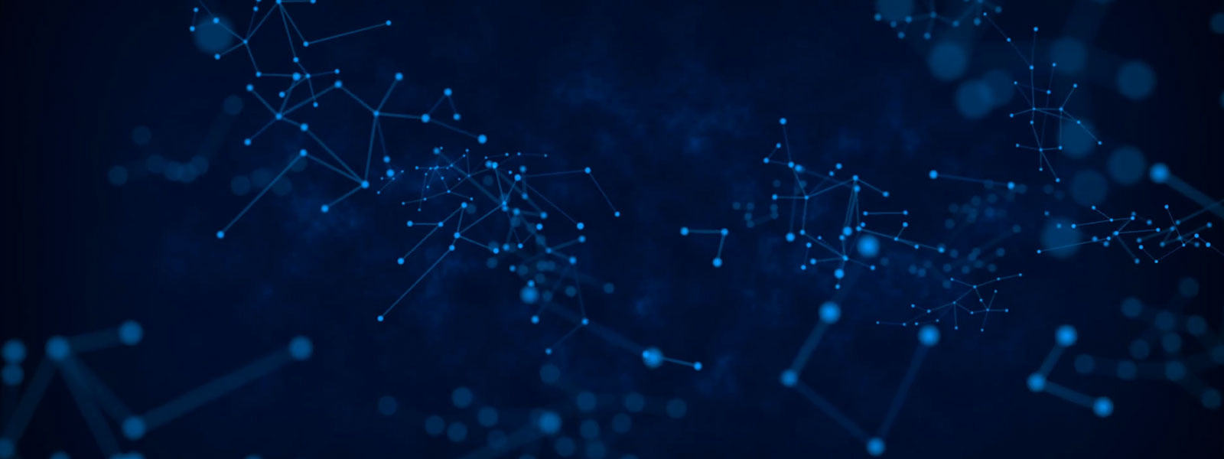
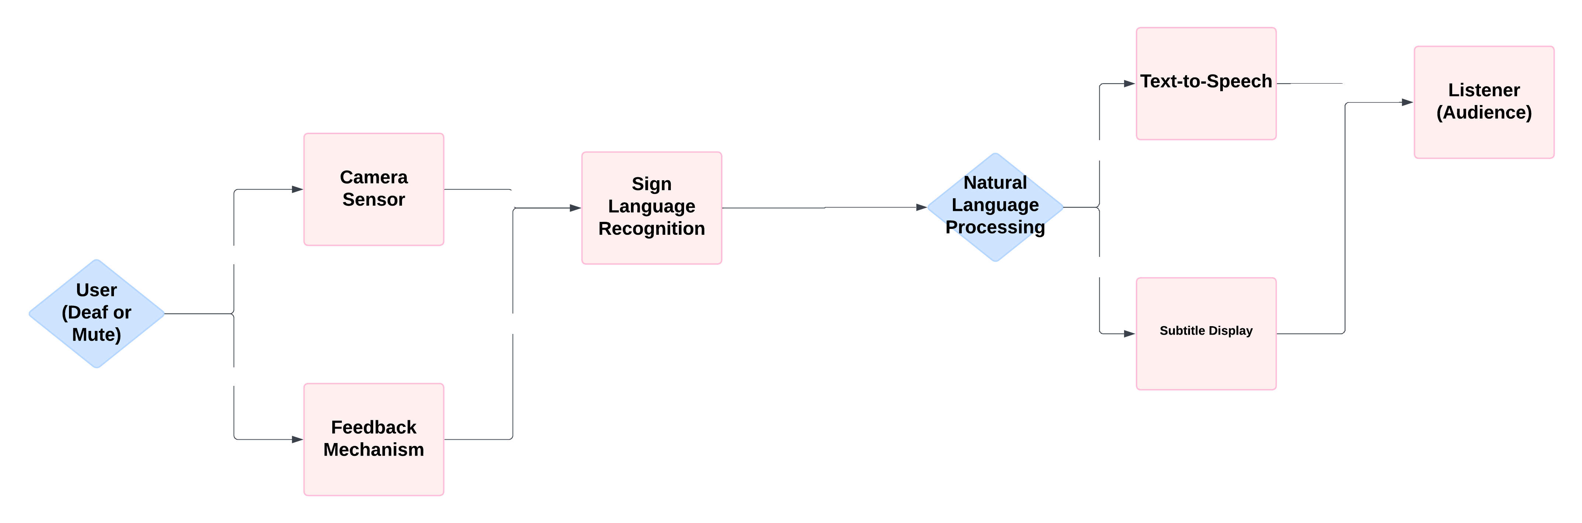
Context flow diagram
Fig 1 : Context Flow Diagram

Slide 6
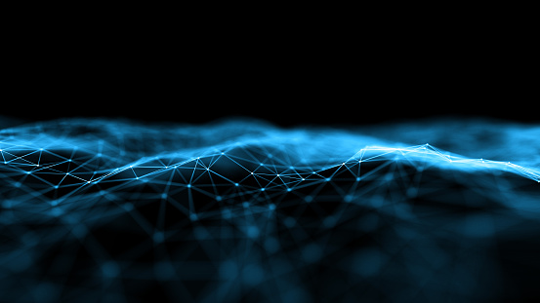
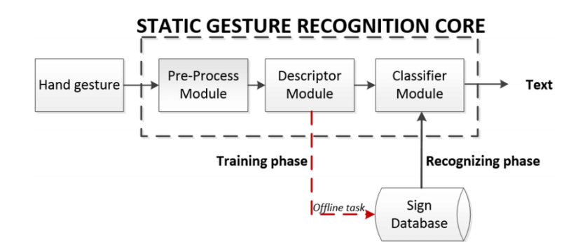
Data flow diagram
Fig 2 : Data Flow Diagram

Slide 7
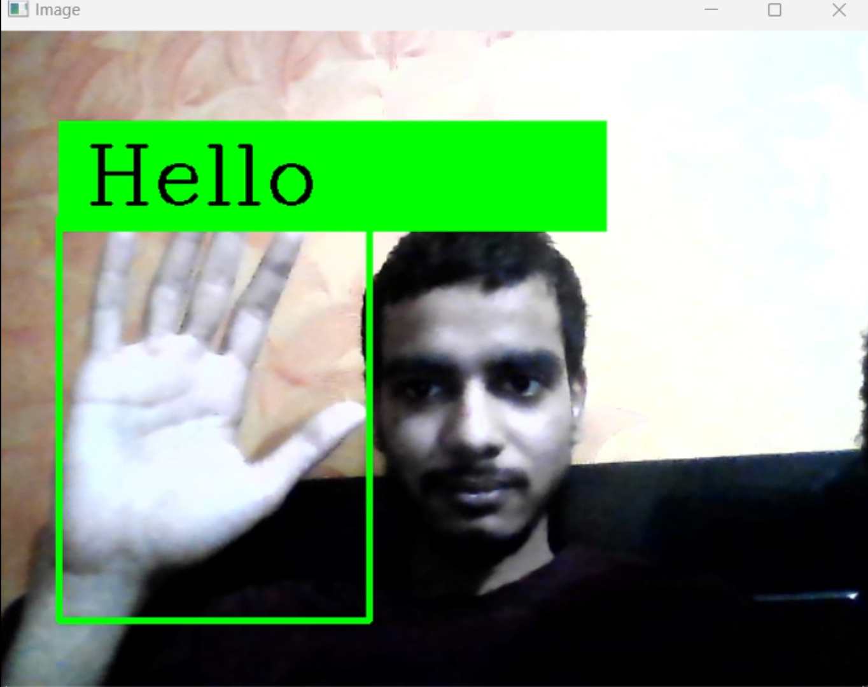
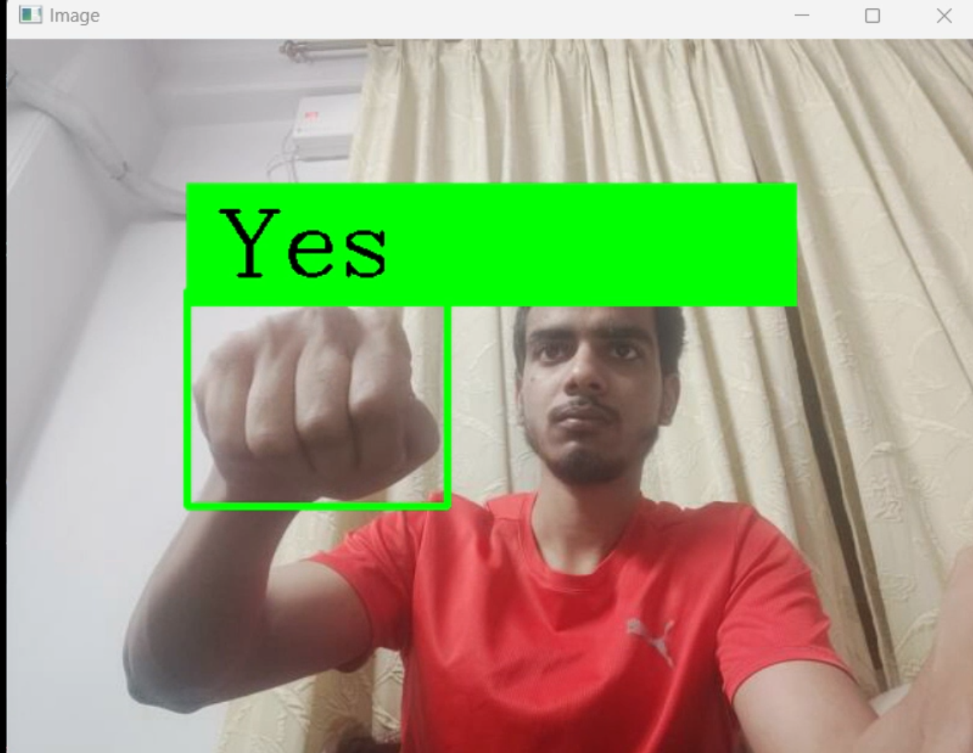
Snapshots
Fig 3 : Sign of Hello
Fig 3 : Sign of Yes

Slide 8
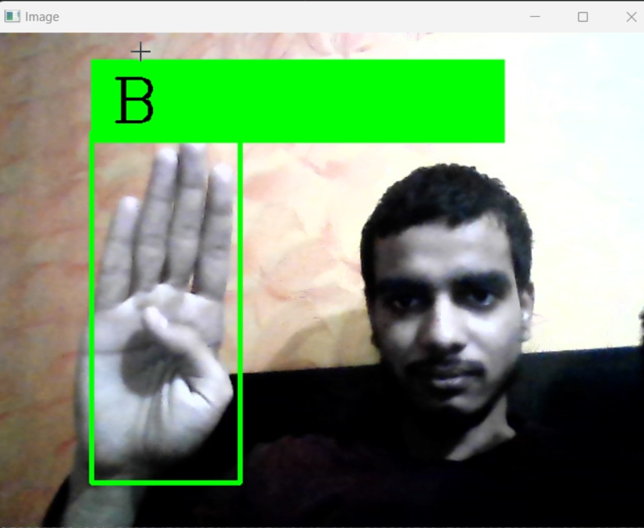
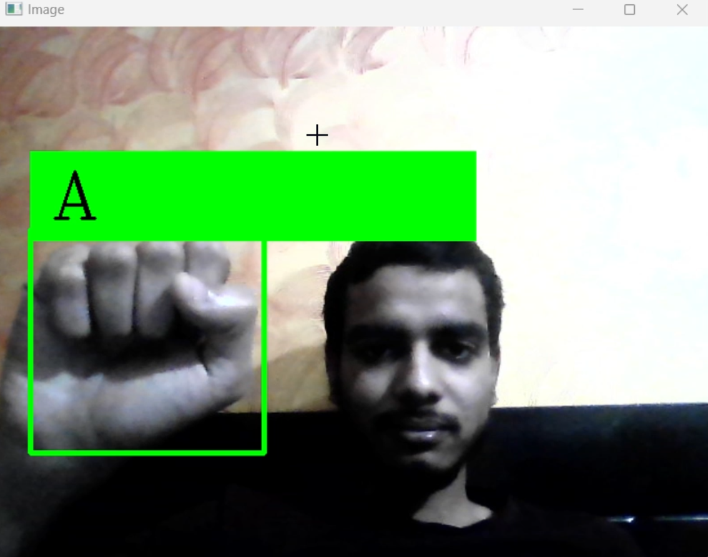
Snapshots
Fig 5 : Sign of B
Fig 6 : Sign of A

Slide 9
Limitations
Accuracy: The system's accuracy in recognizing complex sign language gestures may be limited, leading to occasional misinterpretations or errors in speech conversion.
Speed: Processing speed may pose a challenge, particularly in real-time communication scenarios where instantaneous conversion is crucial for seamless interaction.
Dependency on Lighting and Background: The system's performance may be affected by variations in lighting conditions and background clutter, potentially hindering gesture recognition accuracy.
Hardware Requirements: The system may require specialized hardware components, such as high-resolution cameras and powerful processors, which could limit its accessibility and scalability.
User Interface: The project lacks a user interface and focuses on core functionality to leave scope for improvement.

Slide 10
Future scope
Enhanced Gesture Recognition: Research and development efforts can focus on improving gesture recognition algorithms to achieve higher accuracy.
Real-Time Performance Optimization: Continued optimization of algorithms and hardware can enhance the system's real-time performance, ensuring minimal latency and faster response times in communication.
Adaptive Learning and Personalization: Implementing adaptive learning techniques can enable the system to adapt to individual users' signing styles and preferences, enhancing user experience and communication effectiveness over time.
Professional Integration: Integrating the system into platforms like google meet and micrsoft teams to increase inclusivity of people with hearing impairments.

Slide 11
Conclusion
In conclusion, the development of a Sign Language to Speech Conversion System represents a significant stride towards breaking down communication barriers and promoting inclusivity for individuals with hearing impairments. Throughout this project, we have embarked on a journey to address the critical need for accessible and reliable communication tools that empower deaf individuals to express themselves effectively in a hearing-centric world.

Slide 12
Bibliography
Real Time Hand Gesture Recognition System for Dynamic Applications International Journal of UbiComp (IJU), Vol.3, No.1, January 2012 (Real Time Hand Gesture Recognition System for Dynamic Applications by Siddharth S. Rautaray :: SSRN)
A model-based hand gesture recognition system by Chung-Lin Huang, Sheng-Hung Jeng. (A model-based hand gesture recognition system | Machine Vision and Applications (springer.com))
OpenCV: OpenCV: OpenCV modules
Keras: Keras: Deep Learning for humans
Numpy: NumPy Documentation
Pyttsx3: pyttsx3 - Text-to-speech x-platform — pyttsx3 2.6 documentation

Slide 13
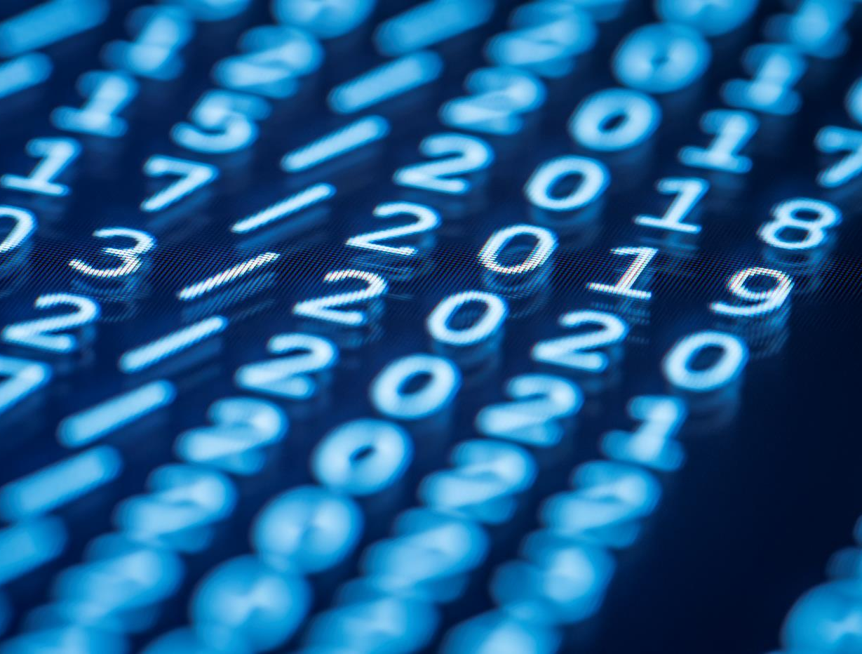
Thank You

